Slide 1

CryptoLiveLeak
February 21, 2018
Whitepaper V. 1.1

Slide 2
Introduction
Frontpage
Introduction
About Us
What we Do
Cryptocurrency Market Cap
Why CryptoLiveLeak
Token Distribution
LEAK SCORE
ROADMAP
Conclusion
Questions and Discusion

Slide 3
About Us
Founder – Ken Garofalo
Ken has years of experience working in the financial operations industry. Coupled with a long tested involvement with proprietary trading U.S. Equity and Options markets. He will use these experiences to drive innovation in the Blockchian and Financial worlds.
Being a serial entrepreneur Ken is keen at identifying a problem with the way a market is currently operating. With steady leadership and a motivated belief in decentralization, Ken will bring forth many useful project implementations in 2018 and the years to come. As a CLL Token Holder you will be able to fully tap into this value added to inefficient markets.

Slide 4

What We Do?
Problem: Users require up to date news and information regarding cryptocurrencies. There is limited mainstream resources available to help onboard new users and stimulate seasoned users.
Solution: We have created an elaborate outlet to voice our ideas and educate to the masses of cryptocurrency investors. Starting from a grassroots campaign we are rising to the heights of our full potential – achieving scalability while innovating, our ideals are high perfprmance interoperable, self governing, and future proof. We are a Cryptocurrency News and Media Platform who interacts with our audience via CLL CryptoLiveLeak Token.
YouTube – Cryptocurrency News and Events Videos
Over 1.1 Thousand Active Subscribers
Instagram/Facebook/Twitter
Channels to release and push media
Telegram - https://t.me/CryptoLiveLeak
Active Community
Latium (LATX Token and Alpha Platform)
Platform to promote content

Slide 5
Cryptocurrency Market Cap

Slide 6
Why CryptoLiveLeak?
Early Access to the Ideas and future ICOs of Ken Garofalo or any CryptoLiveLeak child
Leak Score accumulation incentives to encourage long term holding.
Participate in the blockchain technology revolution
Diversify portfolio holdings
Ever Expanding Cryptocurrency Market Cap – this token can give you potential discounted access to multiple other Crypto Assets to be created in the future.

Slide 7
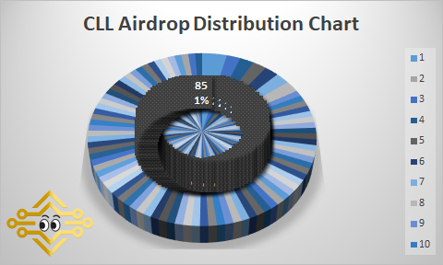
Token Distribution

Slide 8
LEAK SCORE
What is The LEAK SCORE?
The Leak Score will provide incentive for token holders to accumulate and HOLD their CLL tokens - The Holders with the Highest Leak Score will receive the greatest benefits - Up to 50% Discounts from Future Ken Garofalo (Founder) ICO projects, or ICO projects offered from CLL Platform.
How is LEAK SCORE Calculated?
Total CLL Tokens Held
Multiplied by Amount of Days Held since last Outgoing CLL Transaction
=
LEAK SCORE
Benefits of LEAK SCORE
The higher your LEAK SCORE is compared to the rest of the CryptoLiveLeak Token holders, you will receive better reward benefits.
Participate in our future ICOs at Discounted Rates.
Giveaways will be targeted at wallets with higher LEAK SCORES.
Educational Classes and Merchandise will be sold – payment will be accepted in CLL and Discounted Rates depending on your LEAK SCORE

Slide 9
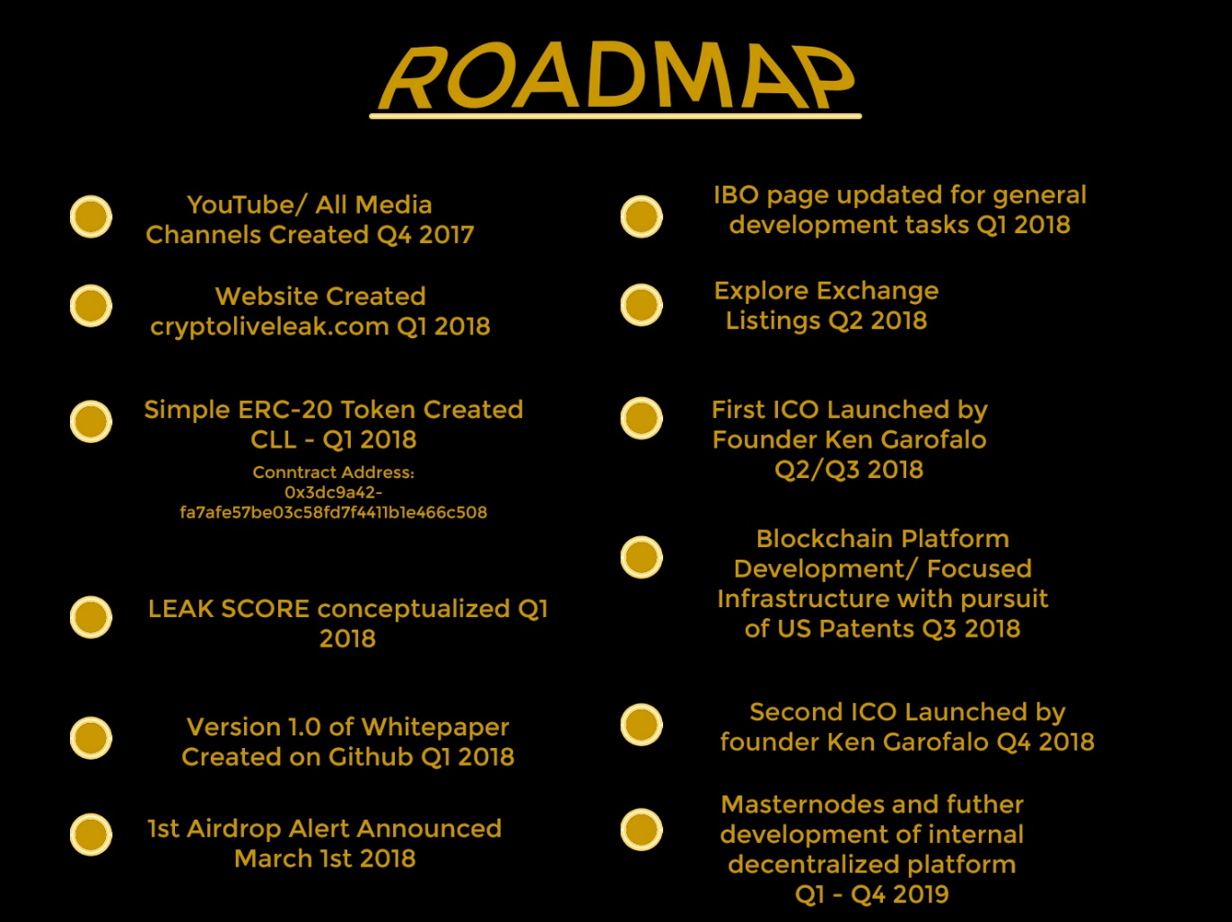
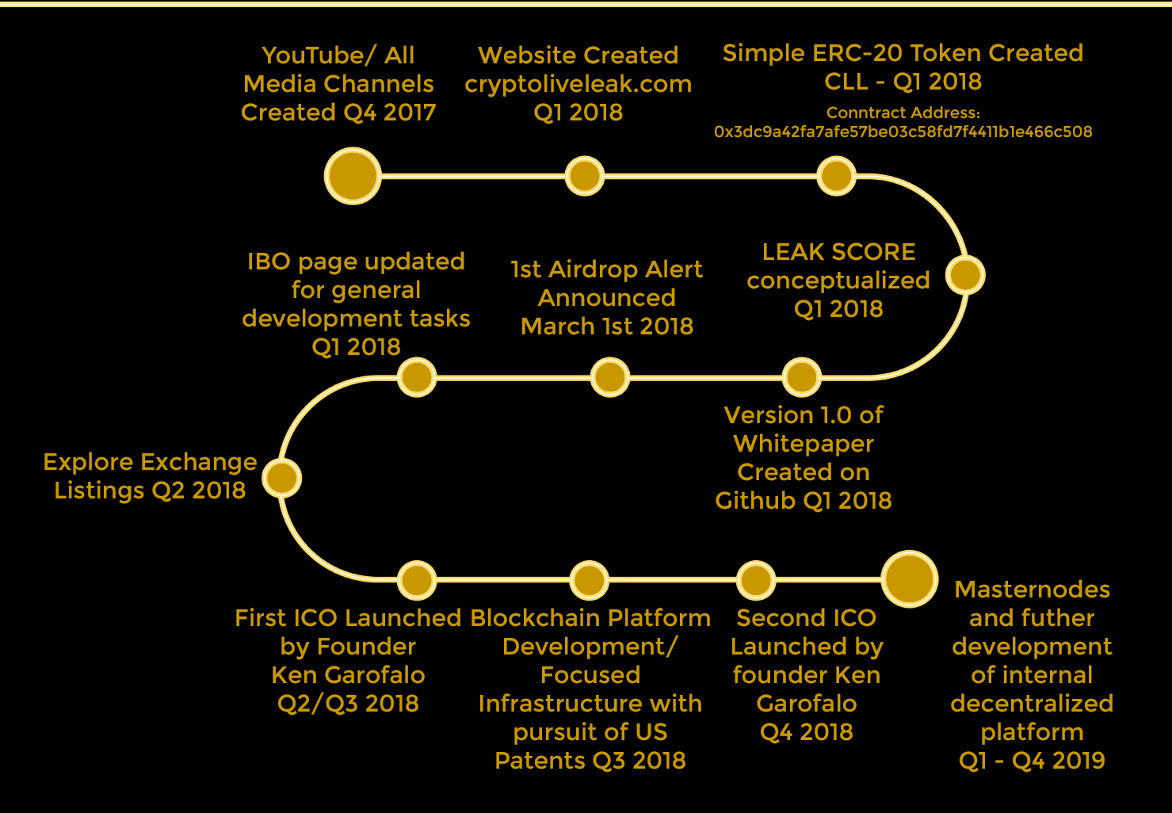
ROADMAP

Slide 10
Conclusion
In Conclusion this CLL is categorized as a UTILITY TOKEN and does not meet requirements to become a registered security.

Slide 11
Questions & Discussion
Please Join us on Telegram: https://t.me/CryptoLiveLeak

